Slide 1
natl_gaps_no_action
1 US WTIV starting with CVOW

Slide 2
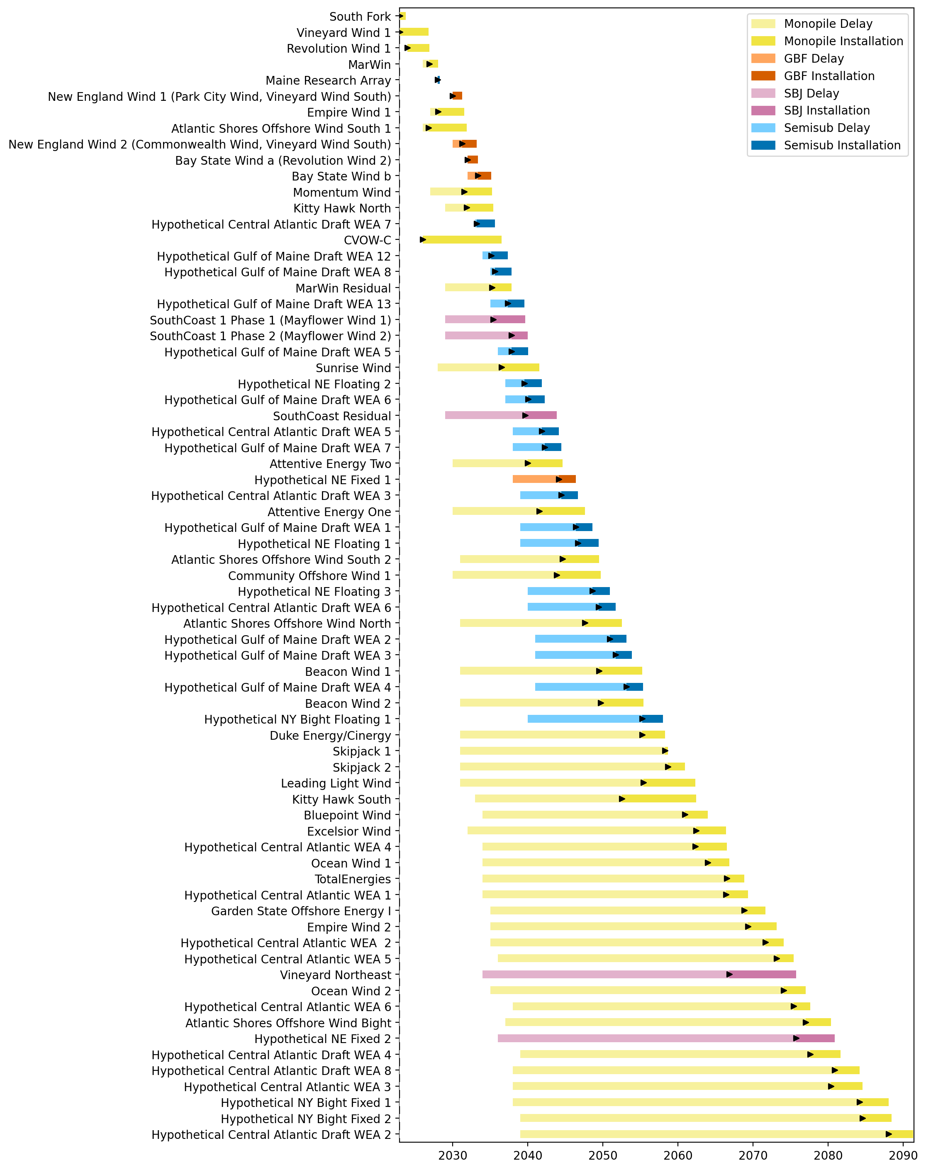
Full Gantt

Slide 3
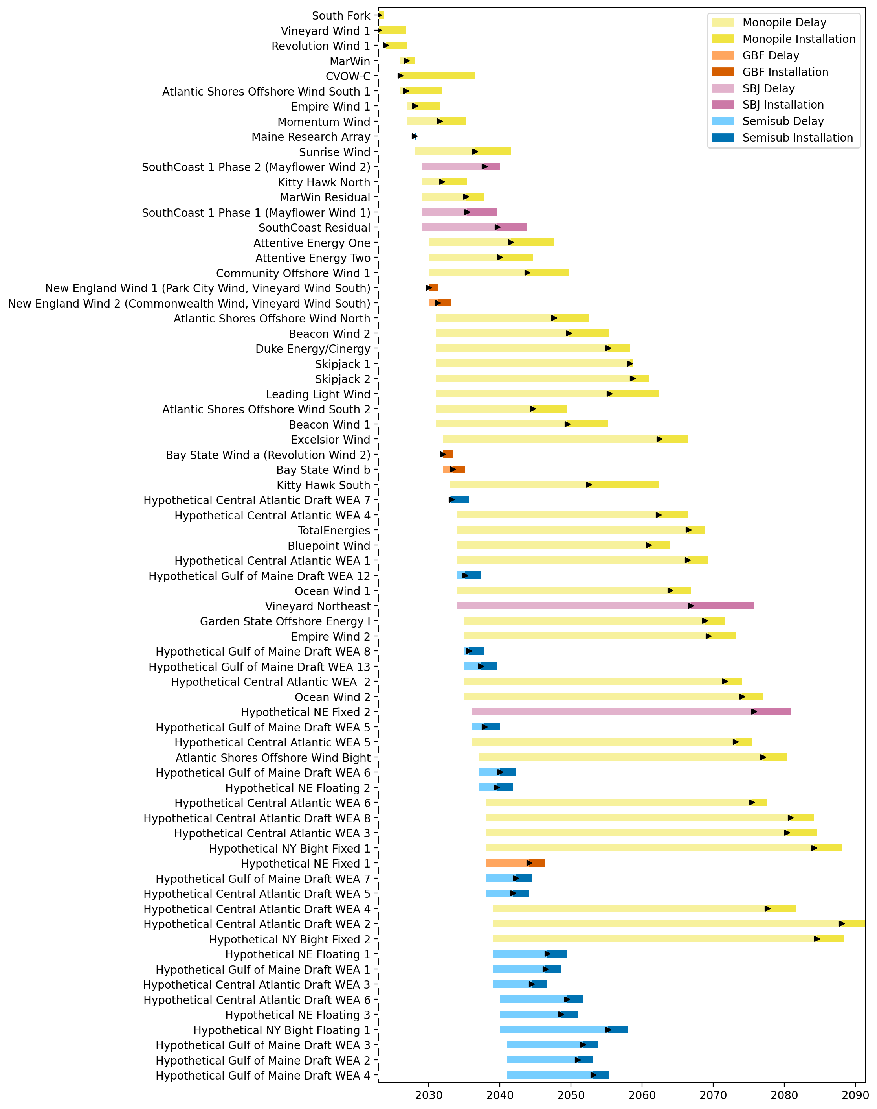
Sorted Full Gantt

Slide 4
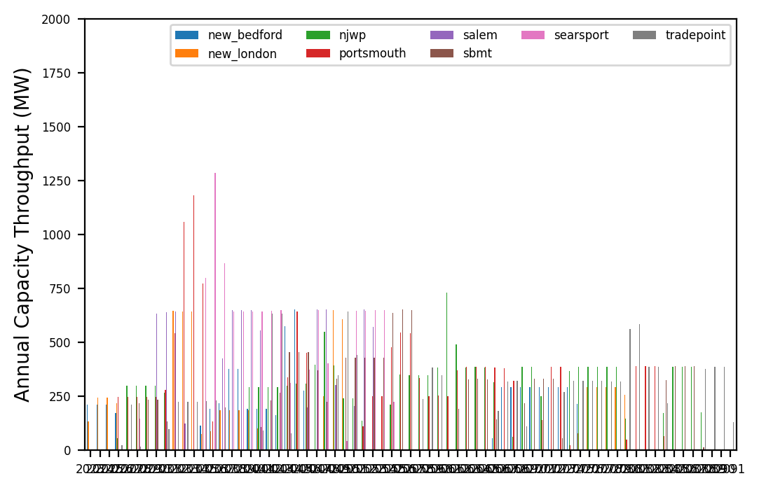
Port Throughput

Slide 5
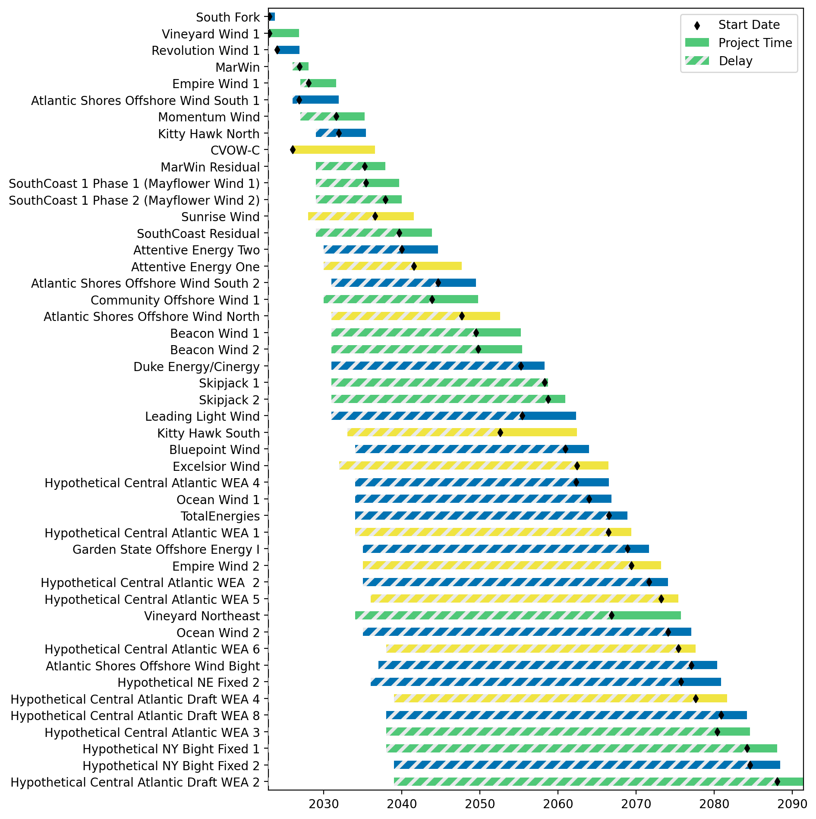
Fixed Gantt

Slide 6
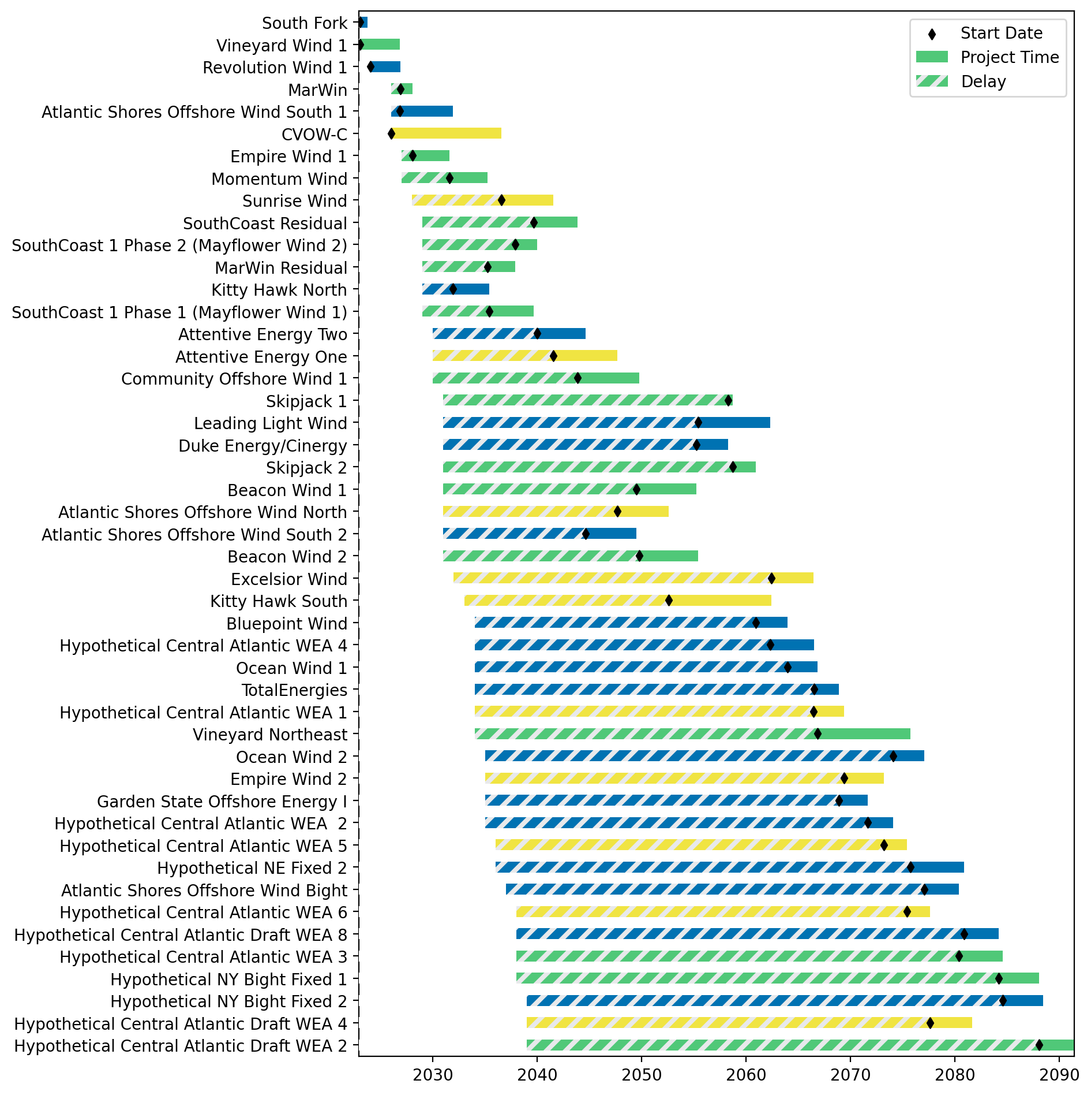
Sorted Fixed Gantt

Slide 7
natl_gaps_2us
1 US WTIV starting with CVOW, then 1 in 2027

Slide 8
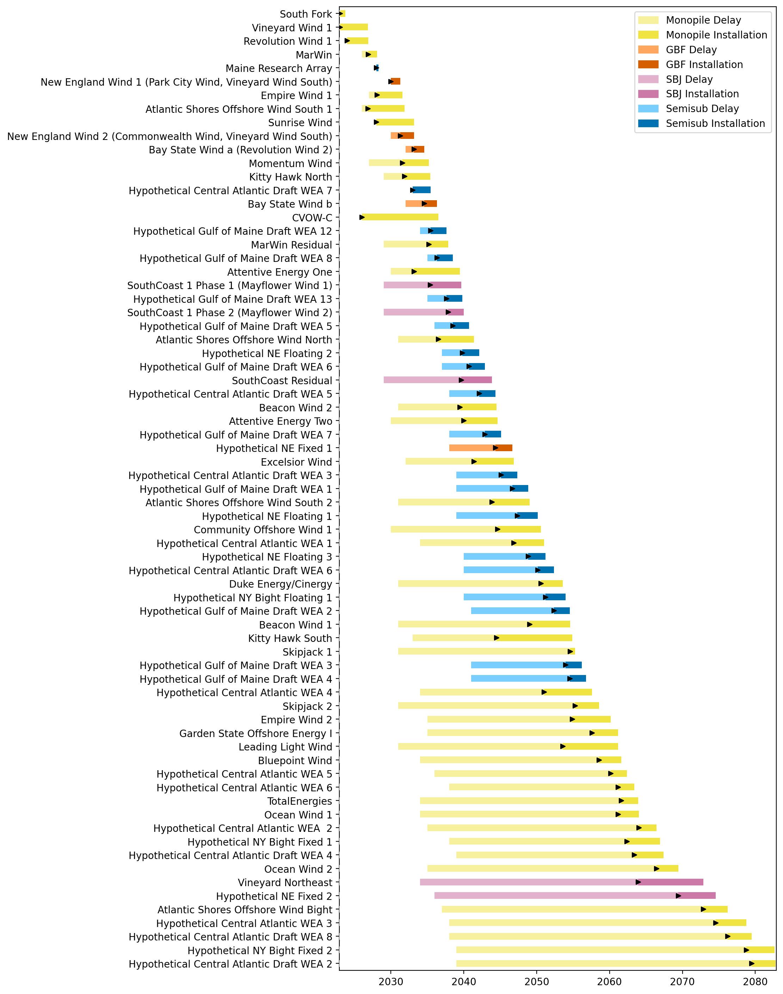
Full Gantt

Slide 9
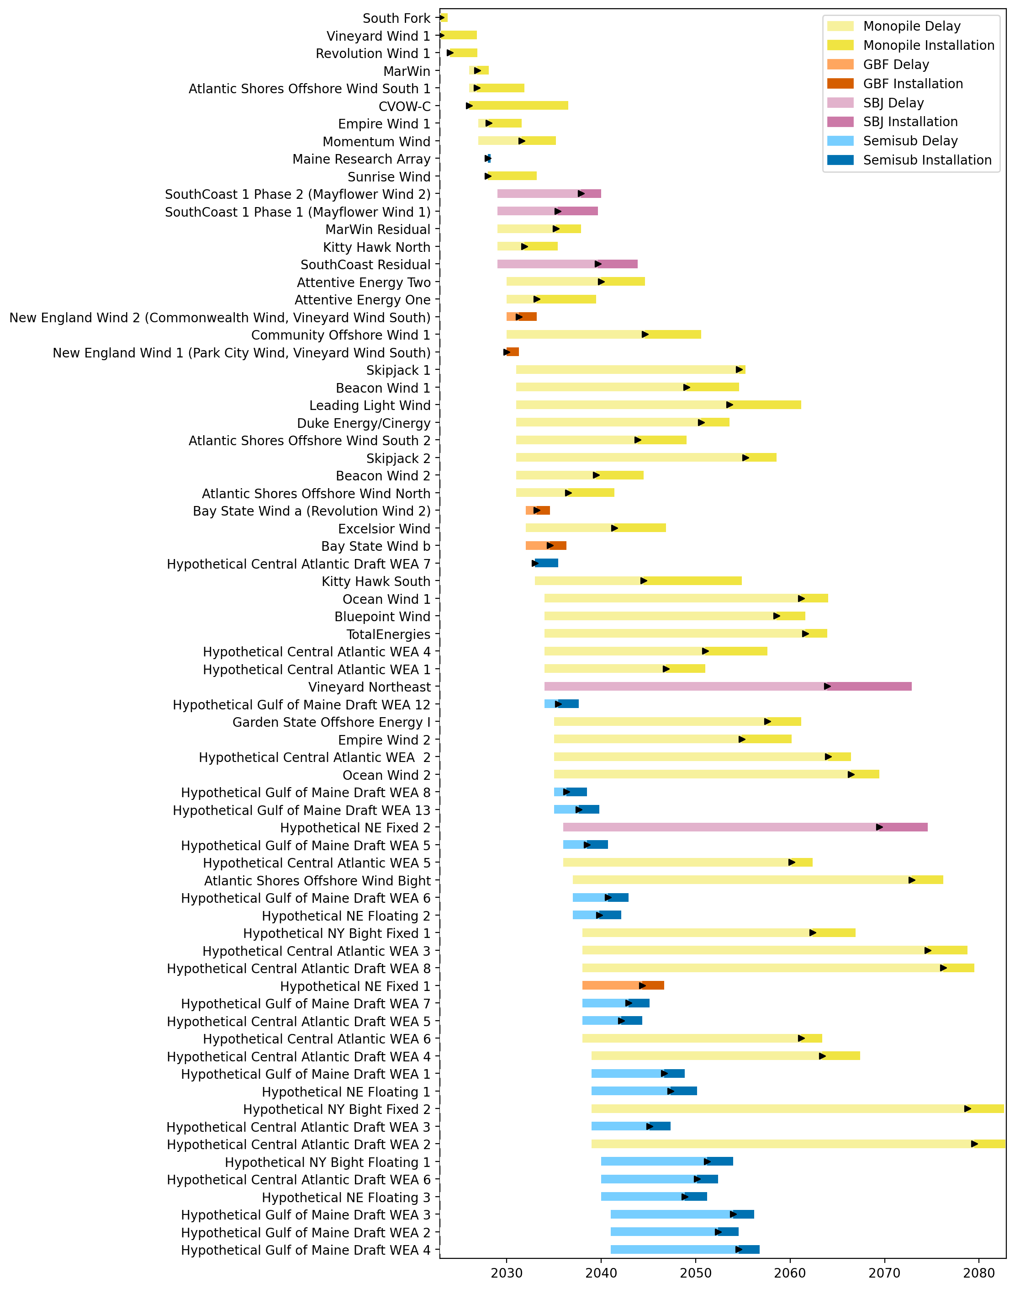
Sorted Full Gantt

Slide 10
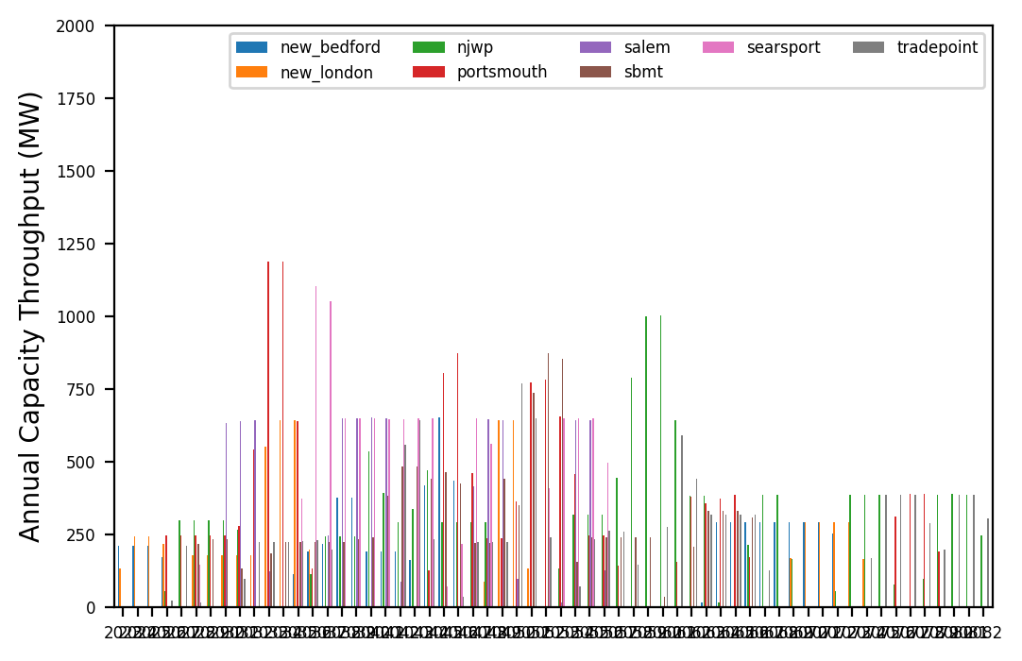
Port Throughput

Slide 11
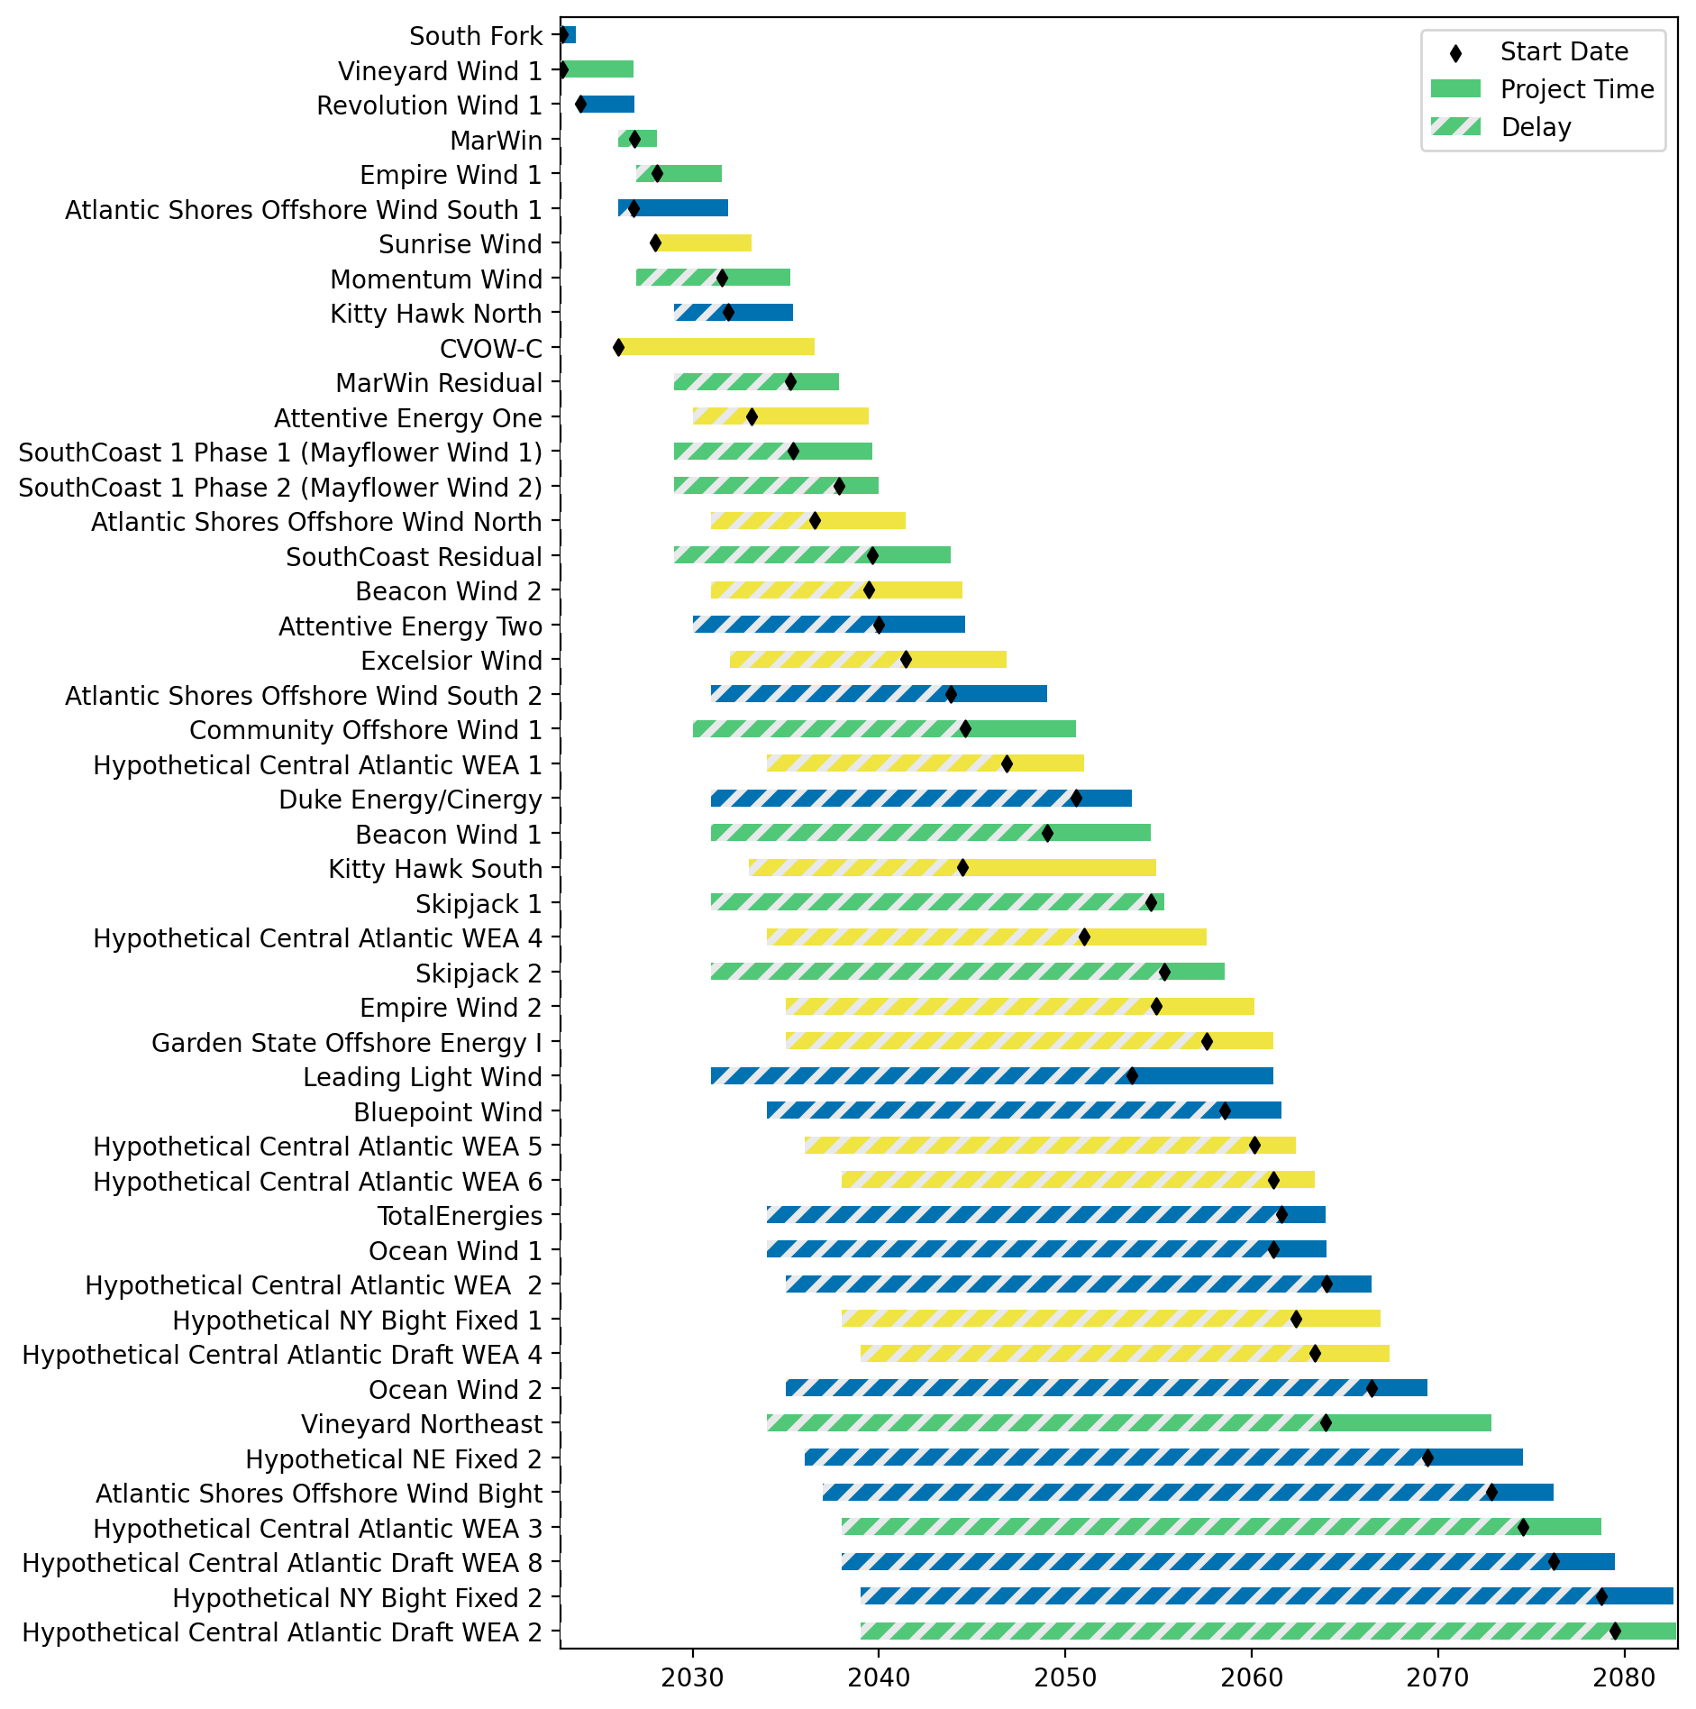
Fixed Gantt

Slide 12
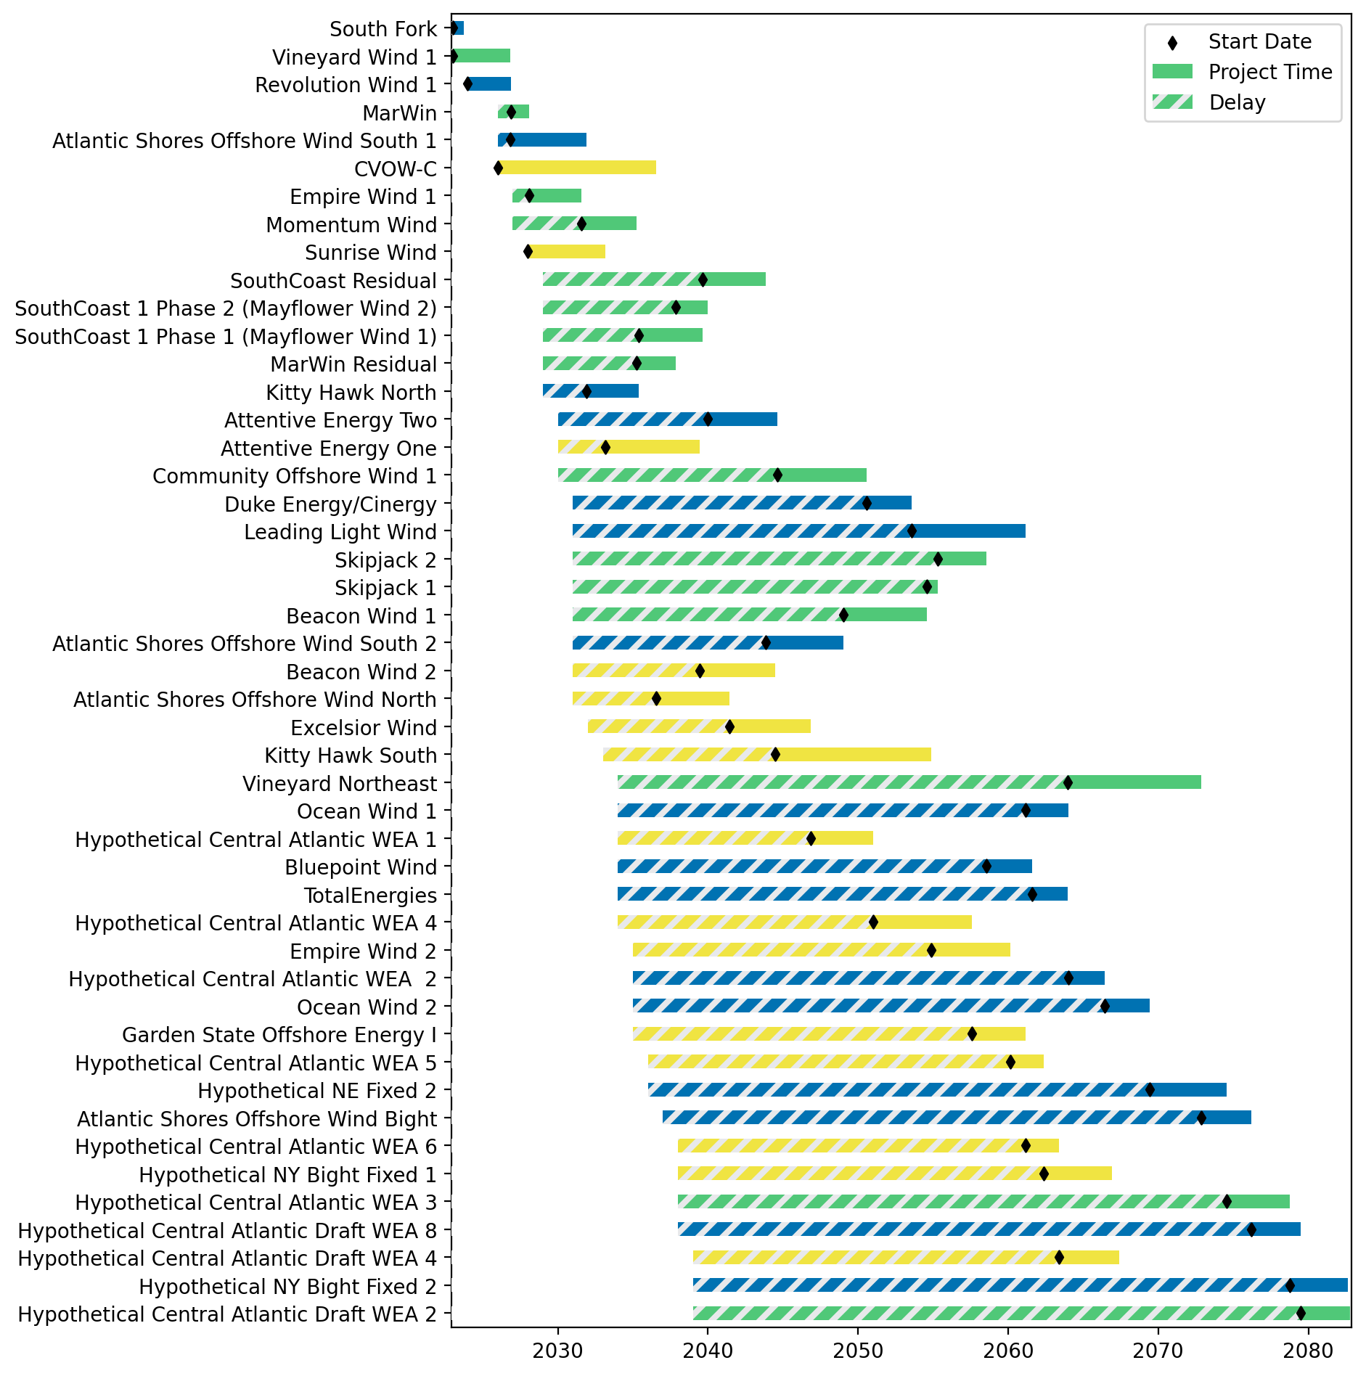
Sorted Fixed Gantt

Slide 13
natl_gaps_3us
1 US WTIV starting with CVOW, then 1 in 2027, 2030

Slide 14
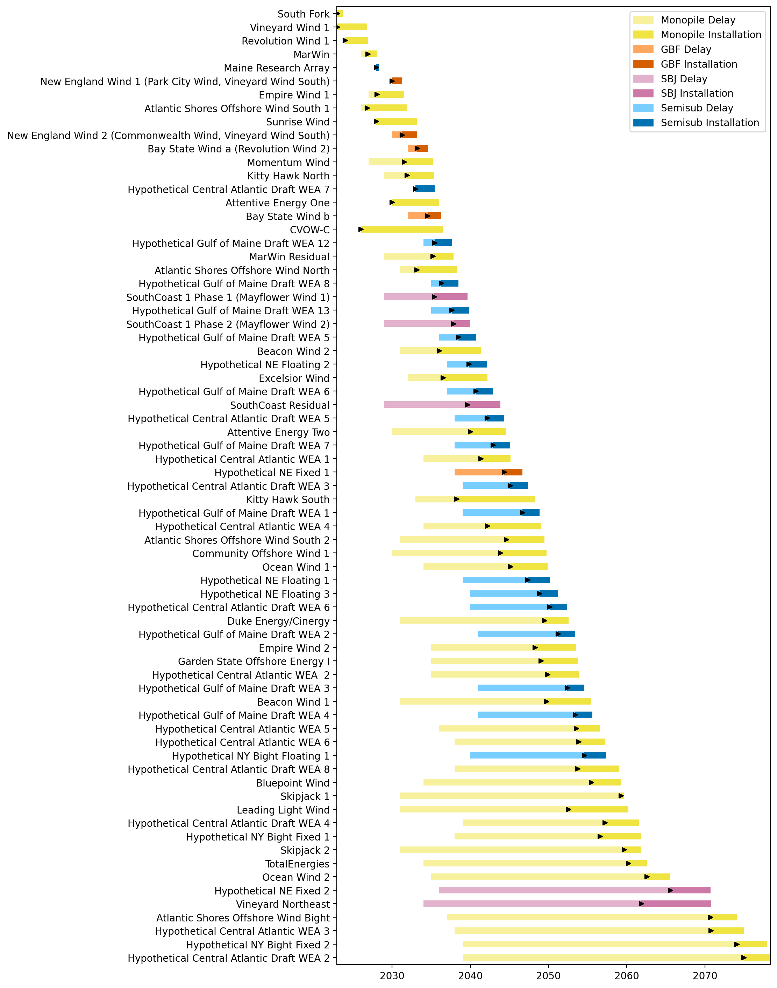
Full Gantt

Slide 15
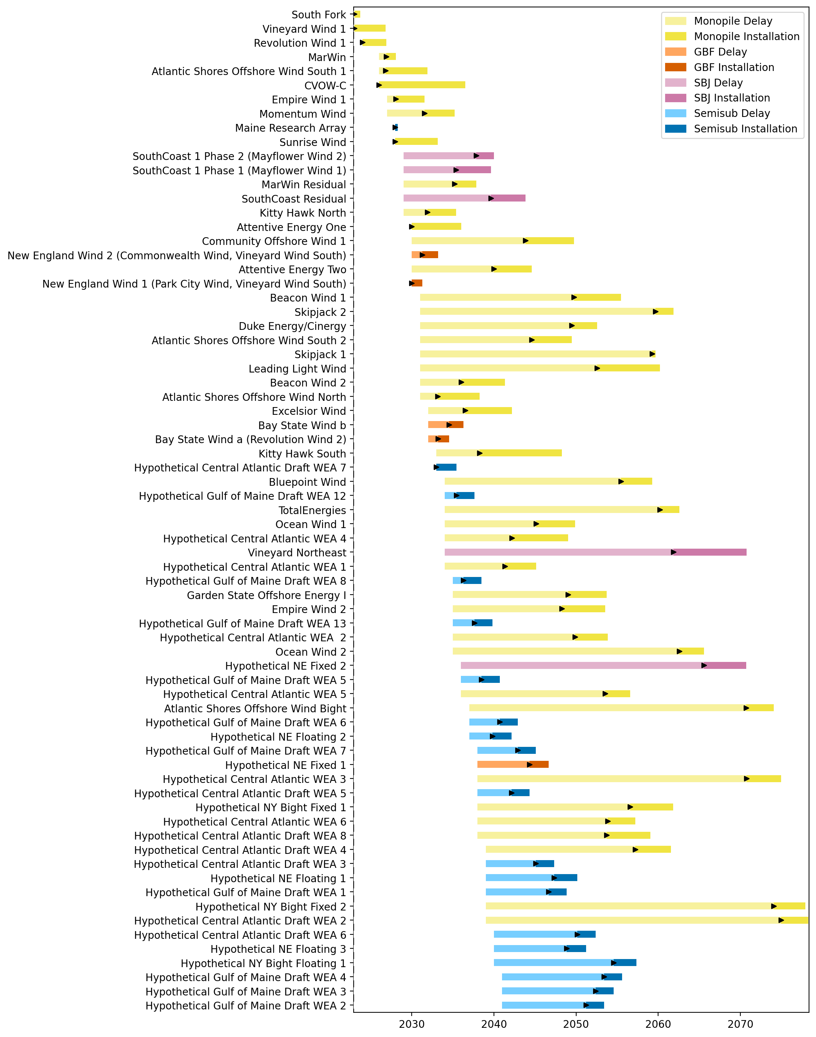
Sorted Full Gantt

Slide 16
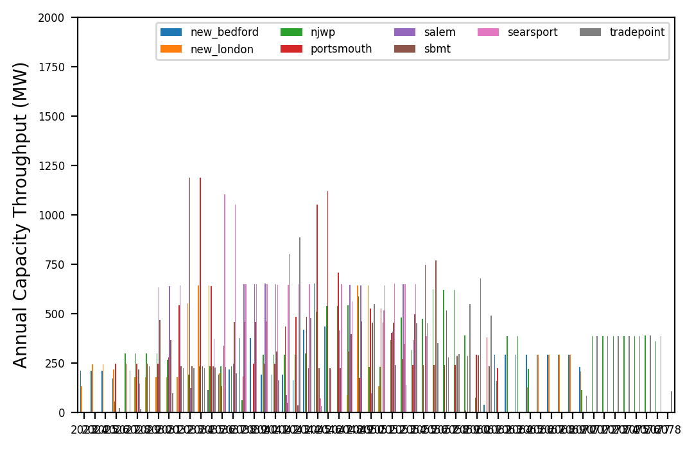
Port Throughput

Slide 17
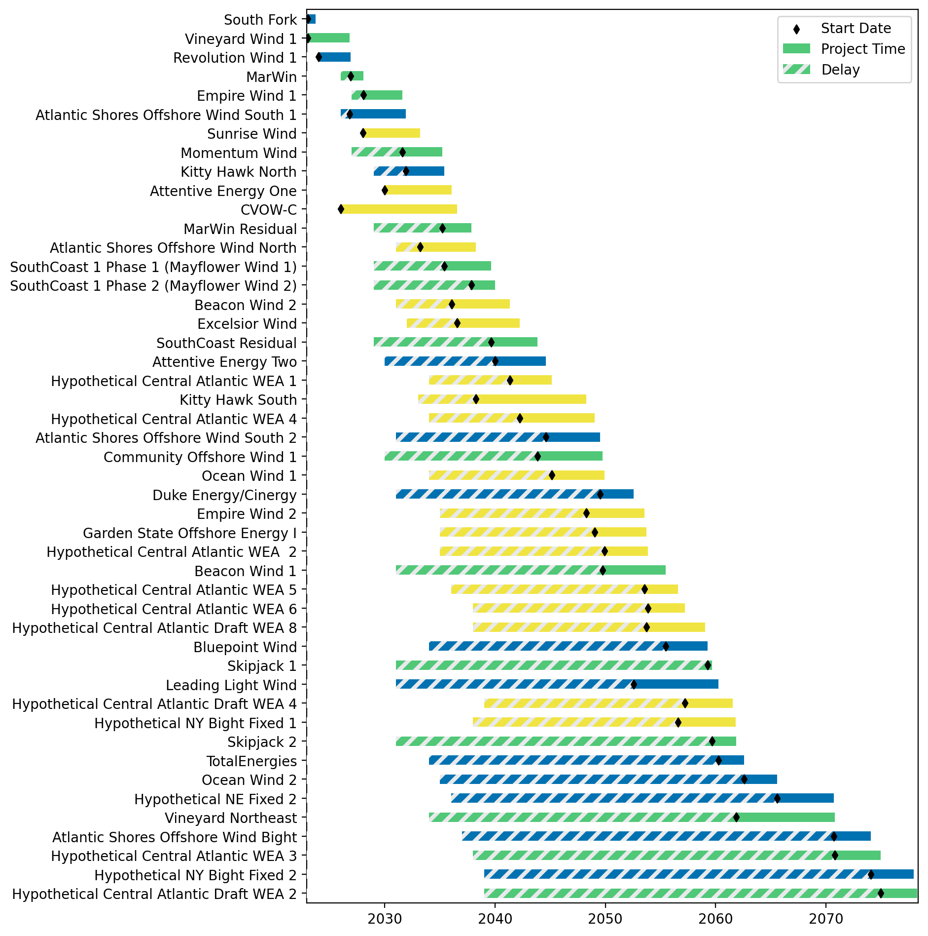
Fixed Gantt

Slide 18
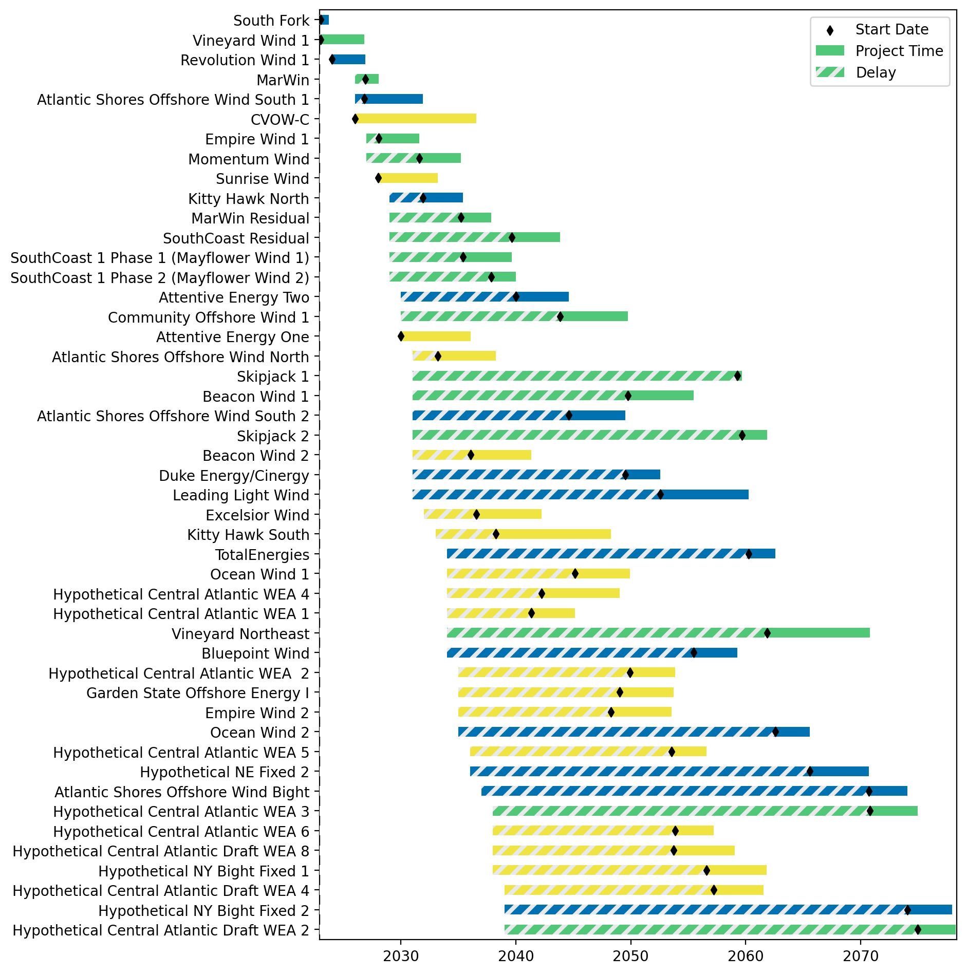
Sorted Fixed Gantt

Slide 19
natl_gaps_4us
1 US WTIV starting with CVOW, then 1 in 2027, 2030, 2033

Slide 20
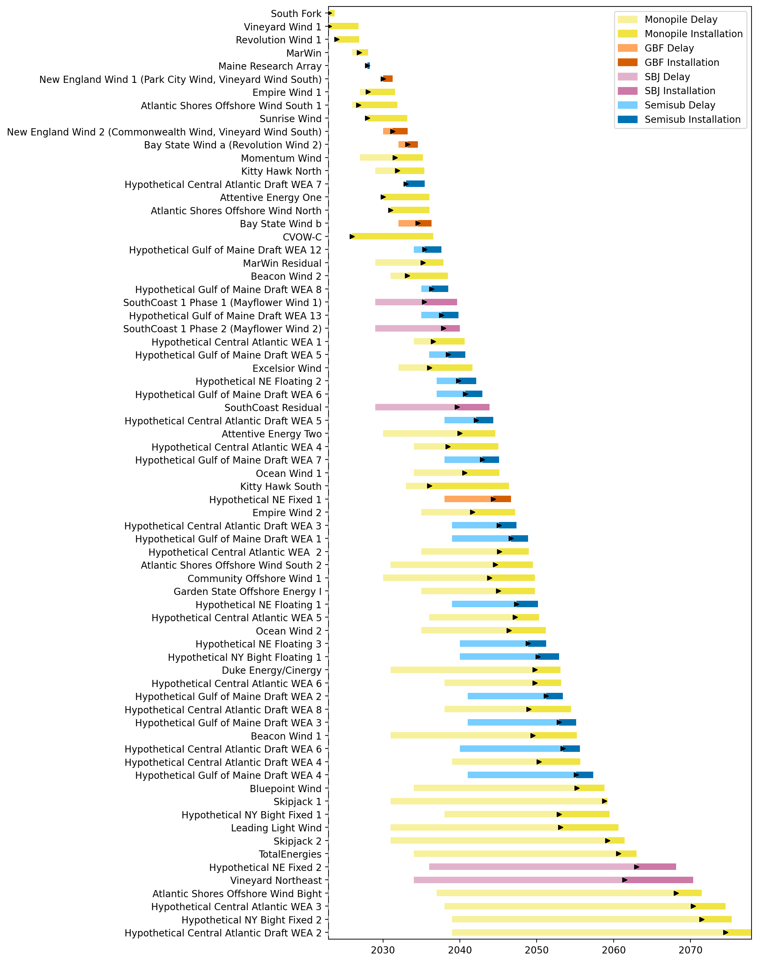
Full Gantt

Slide 21
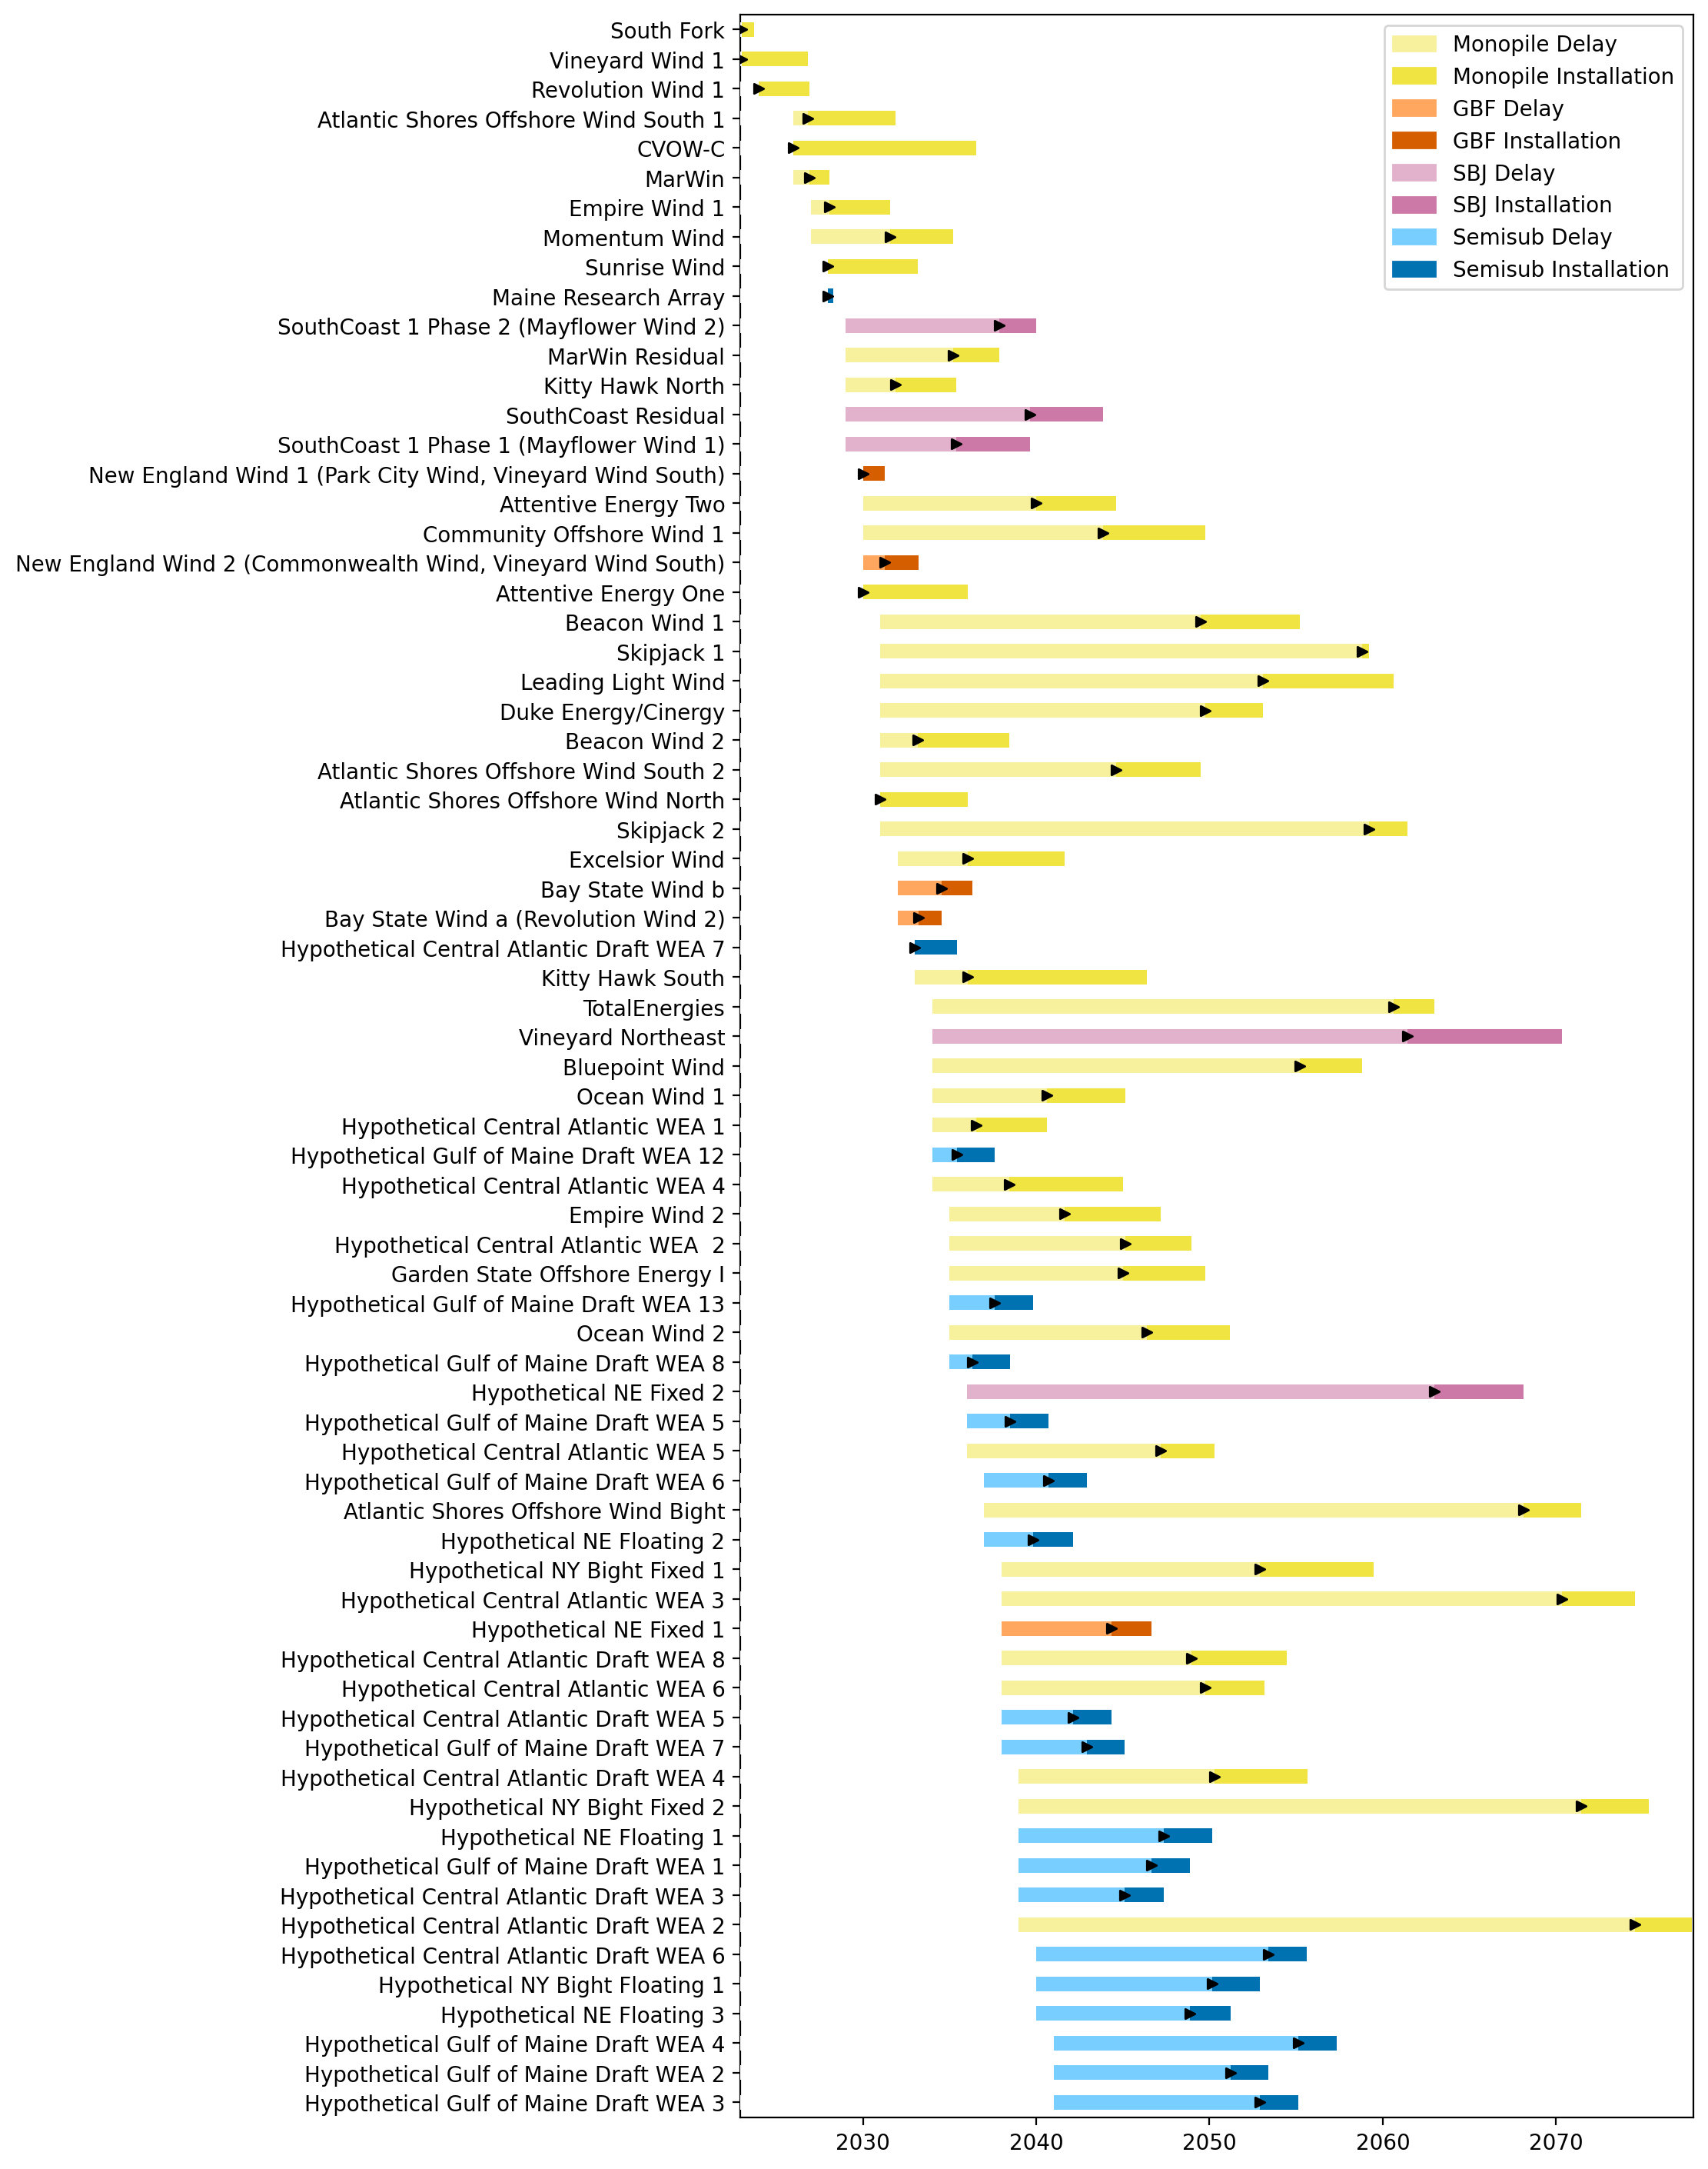
Sorted Full Gantt

Slide 22
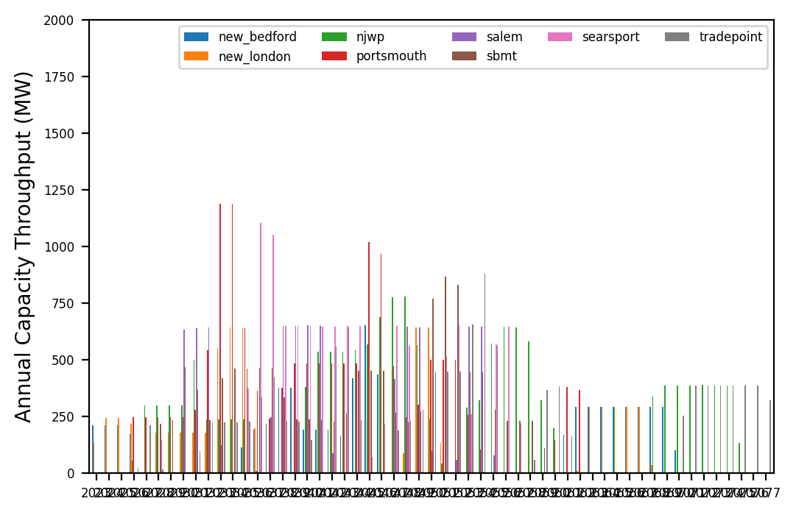
Port Throughput

Slide 23
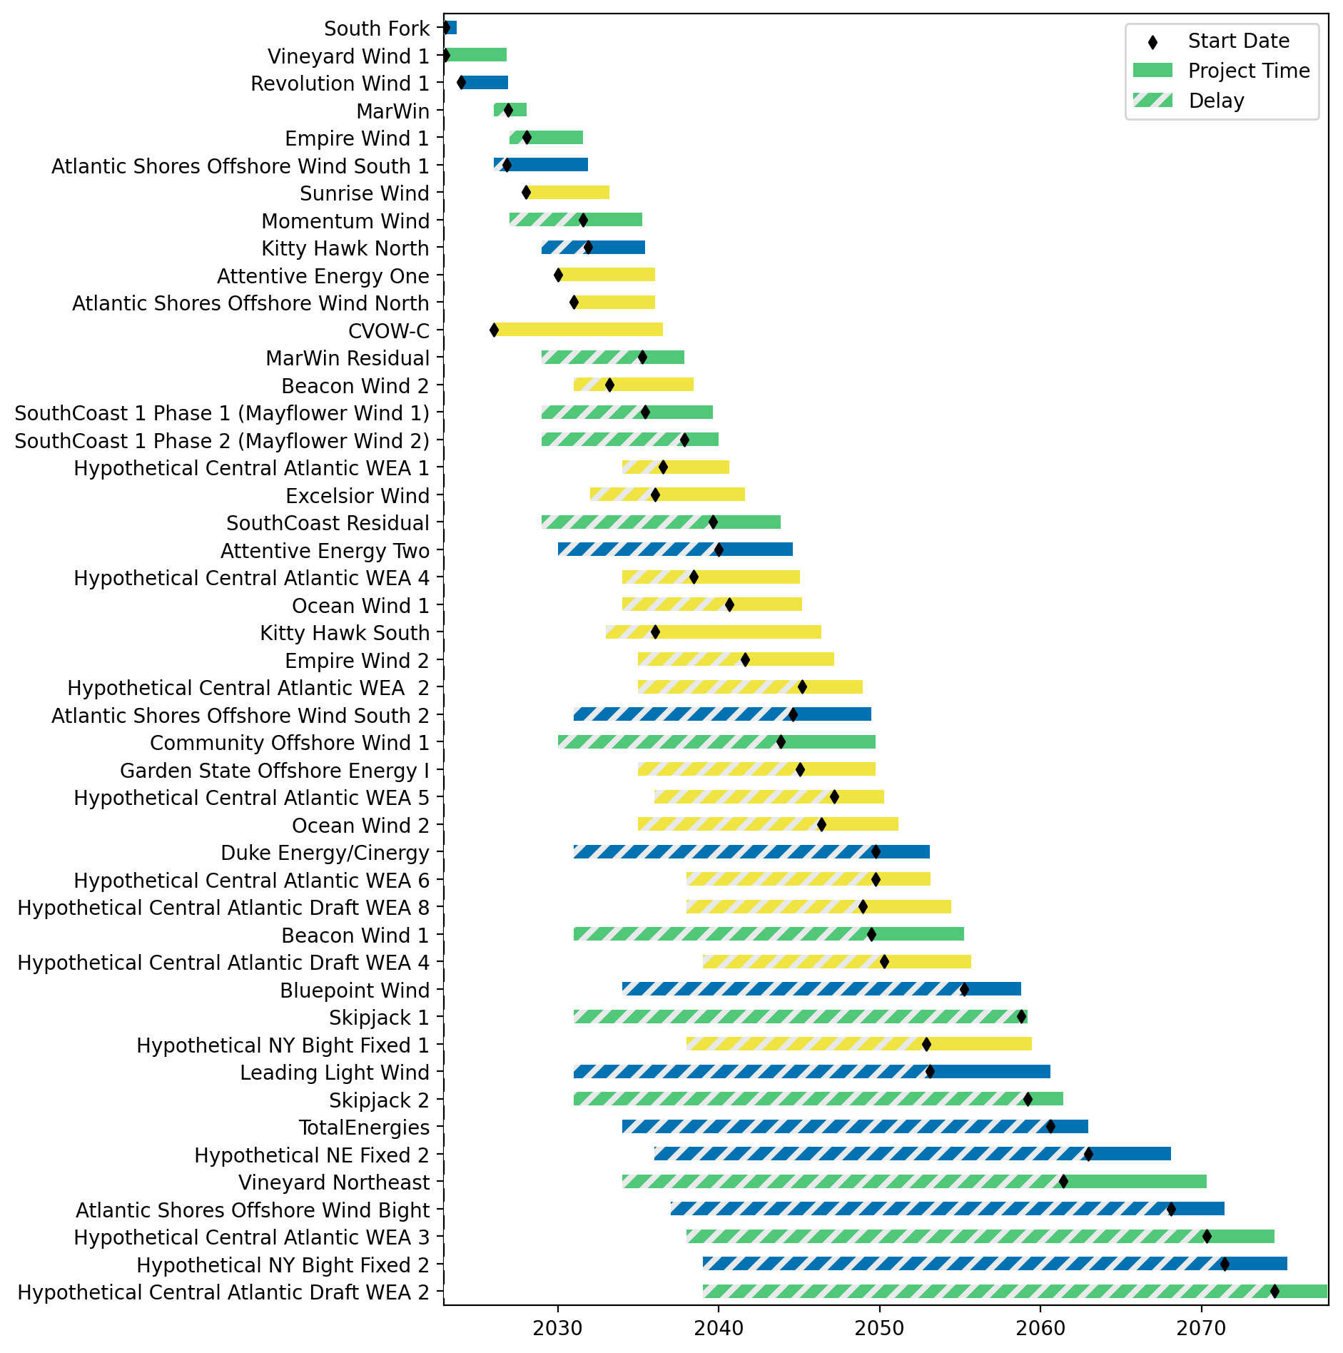
Fixed Gantt

Slide 24
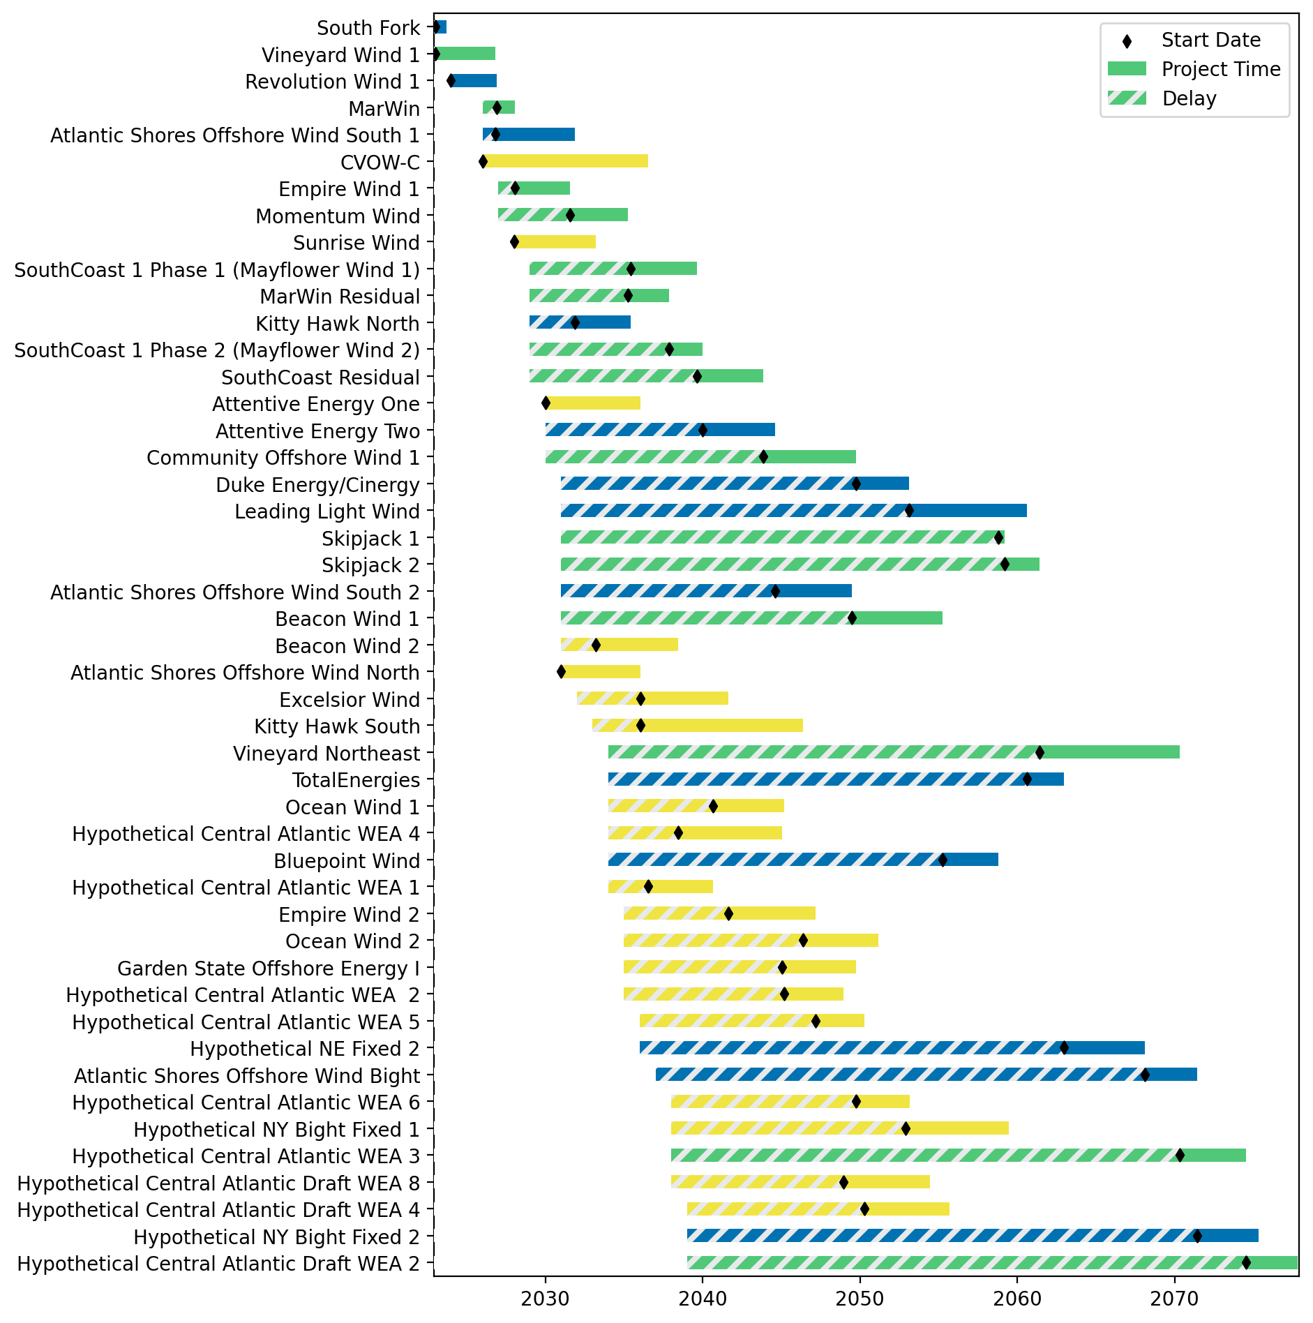
Sorted Fixed Gantt

Slide 25
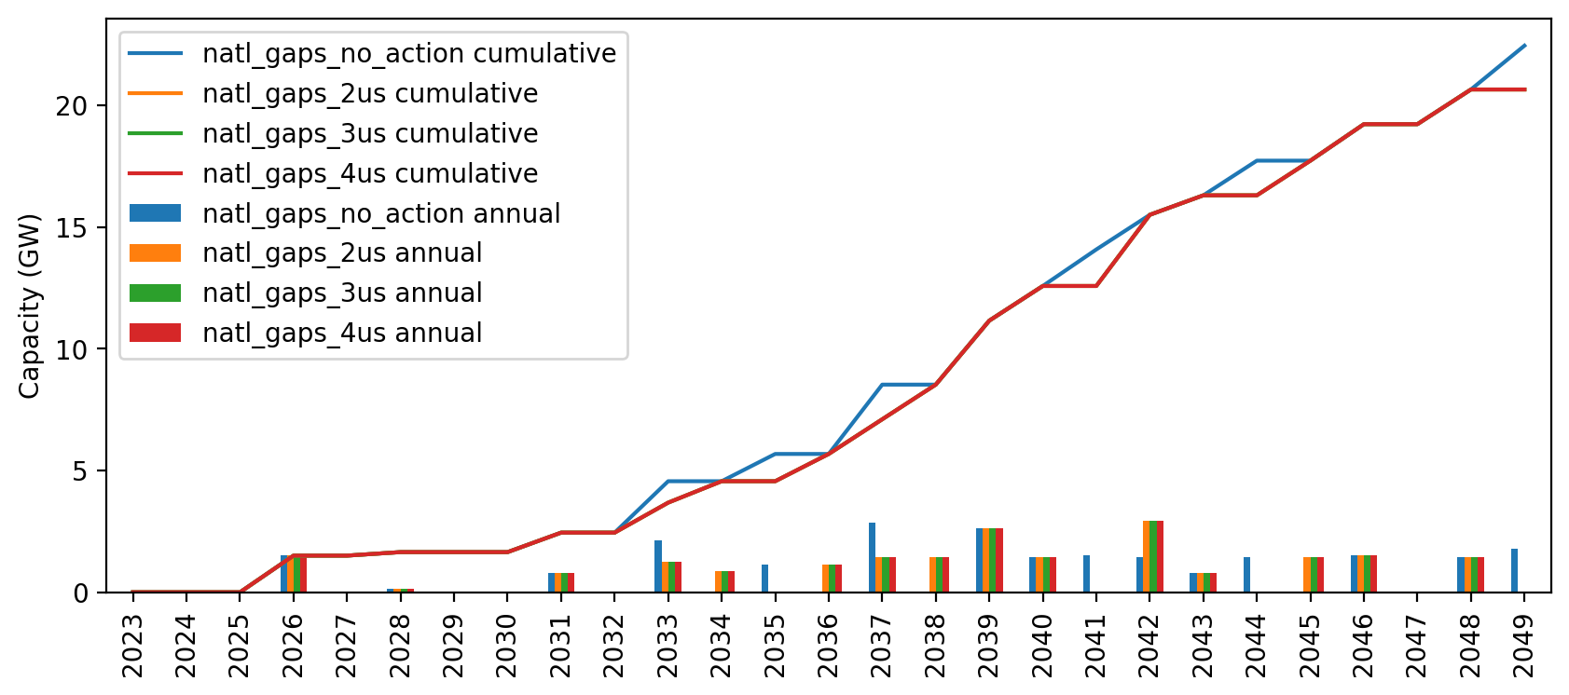
Installed Capacity

